Slide 1
Testing and Testability
P.RAJESH
DEPT OF E.C.E
J.N.T.U.A C.E.A

Slide 2
Content of Syllabus
..\New Microsoft Word Document.docx

Slide 3
1.1 Testing Philosophy
Example :
The teacher sets a domain of knowledge for testing, called the course syllabus.
It may be the contents of a book, class notes, lectures, or some (arbitrary!) combination of all those.
Next, comes the testing method. The teacher asks questions and analyzes the response, perhaps by matching answers to correct ones from the book.
The quality of such a test system depends upon how well the test questions cover the syllabus.
In VLSI testing also, one should know the specification (synonymous to the course syllabus) of the object being tested and then devise tests such that if the object produces the expected response then its conformance to the specification can be guaranteed.

Slide 4
Introduction to Testing
Electronic testing also uses fault modeling and tests are generated for the assumed fault models.
In testing, successful experience with a fault model gives it credibility, and eventually people expect reliability when a high percentage of the modeled faults is tested.

Slide 5
Example 1.1 Testing of students.
In a course on xyzeeology, 70% of the students deserve to pass. We will call them “pass quality” students. Assuming that the number of students in the class is large, we will study the test process using a statistical basis. For a randomly selected student from the class, we define the following events:
PQ: student is pass quality P: student passes the test
FQ: student is fail quality F: student fails the test

Slide 6
Solution:
Given Prob(PQ) = 0.7 Assuming that only pass/fail grades are awarded,
The remaining 30% students are of “fail quality,”
i.e. Prob(FQ)= 0.3. As we know, it is impossible to design a perfect test.
However, our teacher does quite well and 95% of pass quality students actually pass the test.
This is represented by conditional probabilities, and Prob(P/PQ) = 0.95 and
Prob(F/PQ)=0.05
Similarly, the test correctly fails 95% of the fail quality students.

Slide 7
A pass/fail test.
The total probability of passing is,

Slide 8


Slide 9
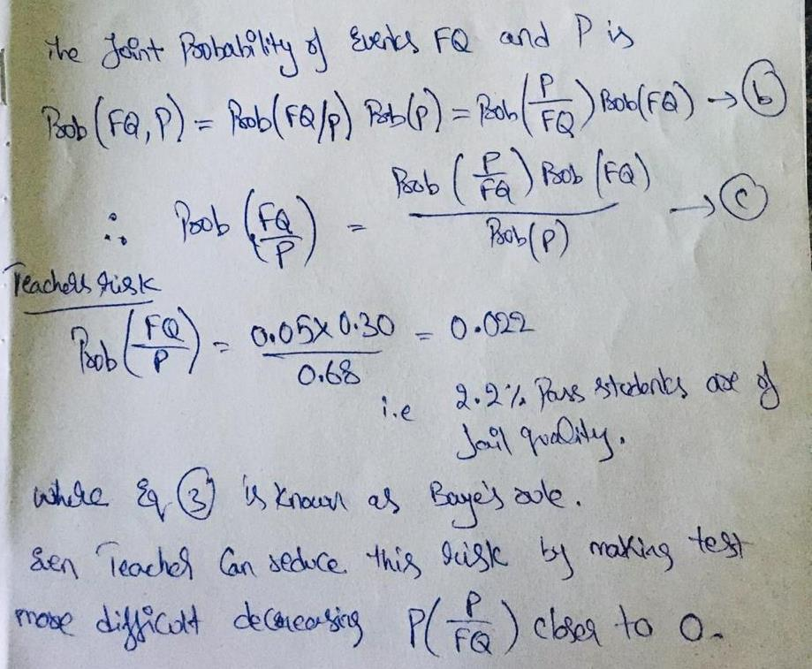

Slide 10
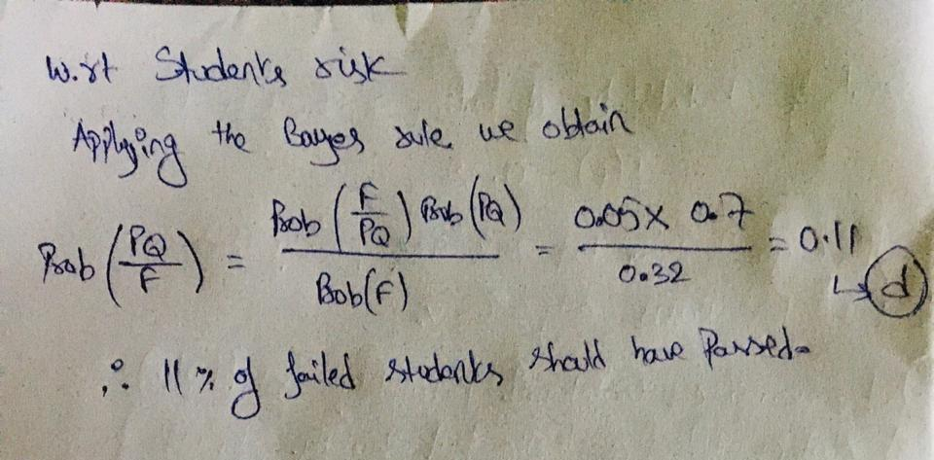

Slide 11
Role of Testing
If you design a product, fabricate and test it, and it fails the test, then there must be a cause for the failure.
Either (1) the test was wrong, or
(2) the fabrication process was faulty, or
(3) the design was incorrect, or
(4) the specification had a problem.
Anything can go wrong.
The role of testing is to detect whether something went wrong and the role of diagnosis is to determine exactly what went wrong, and where the process needs to be altered.

Slide 12
VLSI realization process

Slide 13
Digital and Analog VLSI Testing
The objective of design is to produce data necessary for the next steps of fabrication and testing.
Design has several stages.
The first, known as architectural design, produces a system-level structure of realizable blocks to implement the functional specification.
The second, called logic design, further decomposes blocks into logic gates.
Finally, the gates are implemented as physical devices (e.g., transistors) and a chip layout is produced during physical design.

Slide 14
The physical layout is converted into photo masks that are directly used in the fabrication of silicon VLSI chips.
Fabrication consists of processing silicon wafers through a series of steps involving photoresist, exposure through masks, etching, ion implantation, etc.
Impurities and defects in materials, equipment malfunctions, and human errors are some causes of defects. The likelihood and consequences of defects are the main reasons for testing!
Another very important function of testing is the process diagnosis. We must find what went wrong with each faulty chip, be it in fabrication, in design, or in testing. Or, we may have started with unrealizable specifications.
The faulty chip analysis is called failure mode analysis (FMA.) FMA uses many different test types, including examination through optical and electron microscopes, to determine the failure cause and fix the process.

Slide 15
Requirements and specifications are audited, design and tests are verified, and fabricated parts are tested.
Each testing level performs two functions, and involves different technical personnel.
The first function ascertains that the work still conforms to the objectives of previous levels and meets customer requirements.
The second ascertains that things have been done according to the capabilities of the later process levels.
For example, verification of design and test procedures should ensure that the design meets all functional and other specifications, and that it is also manufacturable, testable, and repairable.

Slide 16
A realistic VLSI realization process

Slide 17
Figure is typically an application specific integrated circuit (ASIC), it applies to many other electronic devices as well.
The process begins with a dialogue between the customer and the marketing engineer.
As specifications are prepared, some involvement of those responsible for later activities (design, manufacture, and test) is advisable to ensure realizable specification.
The systems engineer then begins by constructing an architectural block diagram.
The architecture is verified by high-level simulation and each block is synthesized at the logic-level.
The logic circuit is simulated for the same stimuli (often produced by testbenches) as used for the high-level simulation.
A testbench is hardware description language (HDL) code that, when executed, produces stimuli for the designed circuit Vectors generated by testbenches are compacted or augmented and run through a fault simulator to satisfy some specified fault coverage requirement.

Slide 18
VLSI Technology Trends Affecting Testing
The complexity of VLSI technology has reached the point where we are trying to put 100 million transistors on a single chip, and we are trying to increase the on-chip clock frequency to 1 GHz.

Slide 19
Rising Chip Clock Rates.
Microprocessors represent the leading edge in the VLSI technology
The exponentially rising clock rate indicates several changes in testing over the next 10 years:
1. At-Speed Testing. It has been established that stuck-fault tests are more effective when applied at the circuit’s rated clock speed, rather than at a lower speed.
Stuck-fault testing covers all (or most) circuit signals assuming that a faulty signal may be permanently stuck-at logic 0 or 1.
For a reliable high-speed test, the automatic test equipment (ATE) must operate as fast as, or faster than, the circuit-under-test (CUT.)

Slide 20
2. ATE automatic test equipment Cost.
At the time of writing, a state of the art ATE can apply vectors at a clock rate of 1 GHz
As the development of faster ATE continues, other test methods are also emerging.
An embedded-ATE method, in which ATE functions such as high-speed vector generation and response analysis are added to the chip hardware, have been proposed.
In another method, controllable delays are inserted in the chip hardware such that the critical path delay can be measured by a slow-speed tester.

Slide 21
Automatic Test Equipment
The automatic test equipment is an instrument used to apply test patterns to a device-under-test (DUT), analyze the responses from the DUT, and mark the DUT as good or bad.
The DUT is also sometimes called the circuit-under-test (CUT.)
The ATE is controlled by a central UNIX work station or PC, and one or more additional CPUs is often built into it to provide housekeeping and data reduction capability.
The tester has one or more test heads, which contain buffering electronics local to the DUT, but one mainframe with common instrumentation, power supplies, etc.
The ATE is connected to external equipment that mechanically handles the wafers or IC packages being tested.

Slide 22
3. EMI electromagnetic interference : A chip operating in the GHz frequency range must be tested for electromagnetic interference (EMI.)
This is a problem because inductance in the wiring becomes active at these higher frequencies, whereas it could be ignored at lower frequencies.
The inherent difficulties are:
(1) Ringing in signal transitions along the wiring, because signal transitions are reflected from the ends of a bus and bounce back to the source, where they are reflected again
(2) Interference with signal propagation through the wiring caused by the dielectric permeability and the dielectric permittivity of the chip package; and
(3) Delay testing of paths requires propagation of sharp signal transitions, resulting in high-frequency currents through interconnects, causing radiation coupling.
Delay testing is necessary, because many factors may delay a signal propagating along a path. We must also test the chip interconnect carefully for radiation noise induced errors.

Slide 23
Increasing Transistor Density. Transistor feature sizes on a VLSI chip reduce roughly by 10.5% per year, resulting in a transistor density increase of roughly 22.1% every year.
An almost equal amount of increase is provided by wafer and chip size increases and circuit design and process innovations
1. Test complexity. Testing difficulty increases as the transistor density increases.
This occurs because the internal chip modules (particularly embedded memories) become increasingly difficult to access. Also, test patterns for subassemblies on the chip interfere with each other, due to the need to observe subassembly.
A through sub-assembly
B while stimulating
both sub-assemblies A and B from circuit inputs.

Slide 24
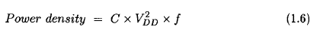
2. Feature scaling and power dissipation. The power density (power dissipation per unit area) of a CMOS chip is given by
where C is the combined node capacitance per unit area that is switched per clock cycle,
VDD is the supply voltage, and f is the clock frequency.
In general, C is proportional to the number of transistors per unit area and the average switching probability of signals.
3. Current testing:
This method is called IDDQ testing While switching, CMOS circuits exhibit an elevated current in the digital logic, which dies out quickly to a small quiescent current (IDDQ) after the gate output settles to a steady state.
Faults, such as transistors stuck-on, shorted wires, shorts from transistor gates to drains, etc., elevate the quiescent current. testing marks the chip as faulty if the measured quiescent IDDQ current through ground busses of the chip exceeds a prespecified threshold.

Slide 25
Integration of Analog and Digital Devices onto One Chip.
Eliminating chip-to-chip delay between an A/D converter and the digital signal processor (DSP) that processes the digitized data. When data goes between two chips, the driving chip inserts a delay to amplify and buffer the output signals, and the receiving chip inserts a delay to condition the signals and propagate them through a “lightening arrester” to eliminate voltage surges coming from people handling the chip.
Integration onto one chip eliminates a significant delay, but brings new issues of testing mixed-signal circuits on one chip.

Slide 26
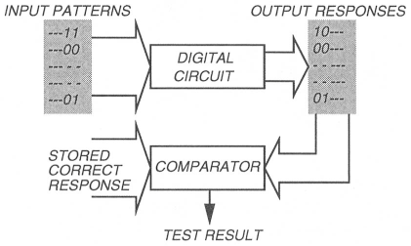
VLSI TESTING PROCESS AND TEST EQUIPMENT
How to Test Chips?
Binary patterns (or test vectors) are applied to the inputs of the circuit.
The response of the circuit is compared with the expected response. The circuit is considered good if the responses match. Obviously, the quality of the tested circuit will depend upon the thoroughness of the test vectors.
Principle of testing.

Slide 27
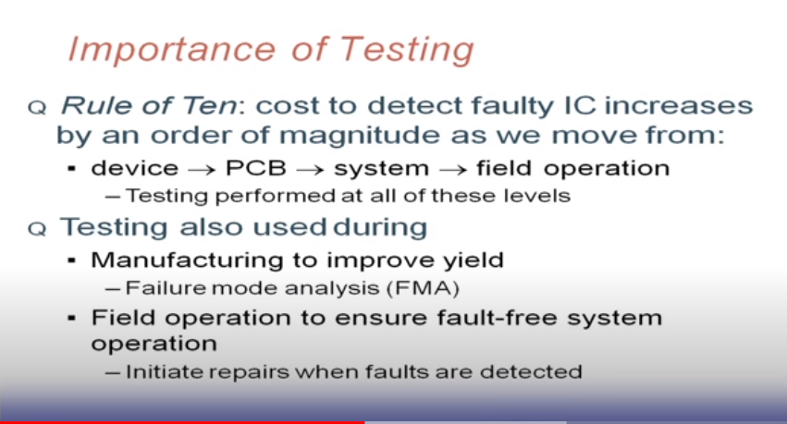

Slide 28
VLSI devices are tested by automatic test equipment (ATE) that performs a variety of tests. Modern ATE is a powerful computer operating under the control of a test program written in a high level language.
Types of Testing
VLSI testing can be classified into four types depending upon the specific purpose it accomplishes
Characterization: Also known as design debug or verification testing,
This form of testing is performed on a new design before it is sent to production.
The purpose is to verify that the design is correct and the device will meet all specifications.
Functional tests are run and comprehensive AC and DC measurements are made.
Probing of internal nodes of the chip, commonly not done in production testing, may also be
required during characterization.
Use of specialized tools such as scanning electron microscopes (SEM) and electron beam testers, and techniques such as artificial intelligence (AI) and expert systems, can be effective.
A characterization test determines the exact limits of device operating values. We generally test for the worst case, because it is easier to evaluate than average cases and devices passing this test will work for any other conditions.

Slide 29
We do this by selecting a test that results in a chip pass/fail decision.
This essentially means repetitively applying functional tests and measuring various DC or AC parameters, as we vary different variables such as (the supply voltage.)
This data is plotted as a Shmoo plot.
Shmoo plot.

Slide 30
Production
Every fabricated chip is subjected to production tests, which are less comprehensive than characterization tests yet they must enforce the quality requirements by determining whether the device meets specifications.
The vectors may not cover all possible functions and data patterns but must have a high coverage of modeled faults. The main driver is cost, since every device must be tested.
Test time (and therefore cost) must be absolutely minimized. Fault diagnosis is not attempted and only a go/no-go decision is made.
Production tests are typically short but verify all relevant specifications of the device. It is an outgoing inspection test of each device, and is not repetitive.
We test whether some device-under-test (DUT) parameters are consistent with the device specifications under normal operating conditions.
We test either at the speed required by the application of the device or at the speed guaranteed by the supplier.

Slide 31
Burn-in
All devices that pass production tests are not identical. When put to actual use, some will fail very quickly while others will function for a long time. Burn-in ensures reliability of tested devices by testing, either continuously or periodically, over a long period of time, and by causing the bad devices to actually fail.
Incoming Inspection
System manufacturers perform incoming inspection on the purchased devices before integrating them into the system.
the incoming inspection may be done for a random sample with the sample size depending on the device quality and the system requirement.
The most important purpose of this testing is to avoid placing a defective device in a system assembly where the cost of diagnosis may far exceed the cost of incoming inspection.

Slide 32
Types of Tests:
Although some testing is done during device fabrication to assess the integrity of the process itself, most device testing is performed after the wafers have been fabricated.
The first test, known as wafer sort or probe, differentiates potentially good devices from defective ones.
Specially designed tests are applied to certain test sites containing specific test patterns. These are designed to characterize the processing technology through measurement of parameters such as gate threshold, polysilicon field threshold, bypass, metal field threshold, poly and metal sheet resistances, contact resistance, etc.
In general, each chip is subjected to two types of tests:
Parametric Tests.
DC parametric tests include shorts test, opens test, maximum current test, leakage test, output drive current test, and threshold levels test.
AC parametric tests include propagation delay test, setup and hold test, functional speed test, access time test, refresh and pause time test, and rise and fall time test.
These tests are usually technology-dependent. CMOS voltage output measurements are done with no load while TTL devices require current load.

Slide 33
(2) Functional Tests.
These consist of the input vectors and the corresponding responses. They check for proper operation of a verified design by testing the internal chip nodes.
Functional tests cover a very high percentage of modeled (e.g., stuck type) faults in logic circuits and their generation.
Often, functional vectors are understood as verification vectors, which are used to verify whether the hardware actually matches its specification.
Functional tests may be applied at an elevated temperature to guarantee specifications:
For example, testing may be done at 85° C to guarantee 70° operation. This is called guard banding.
Another application is in speed binning to grade the chips according to performance.
This may be done by applying the tests at several voltages and at varying timing conditions (e.g., clock frequency.)

Slide 34
Memory tests are functional:
No stuck-type fault coverage is evaluated for these tests, these are designed to check functional attributes such as address uniqueness, address decoder speed, cell coupling, column and row coupling, data sensitivity, write recovery, and refresh.
Elaborate testing may require long vector sequences.
To increase throughput, memory testers sometimes have parallel testing capability.
Specialized testers may even be able to repair redundant cells used in large memories (256 M bits) to enhance yield.
Circuit boards consist of previously-tested components.
A primary objective of board testing is to check the printed wiring and the contacts between wires and components. It is possible to perform a bare-board testing of interconnections before the components are inserted.
After the components (such as chips) are in place, in-circuit testing (through a bed-of-nails fixture) is often used to verify the performance of individual components, although the bed-of-nails fixture is becoming obsolete.
Finally, functional testing determines whether or not individual components, possibly designed with different technologies, function as a system and produce the expected response.

Slide 35
The ATE employed for boards is different from that used for chips.
Test Specifications and Test Plan:
• Functional Characteristics – Algorithms to be implemented, I/O signal characteristics (timing waveforms, signal levels, etc.), data and control signal behavior, clock rate.
• Type of Device – Logic, microprocessor, memory, analog, etc.
• Physical Characteristics – Package, pin assignments, etc.
• Technology – CMOS (or gate array), custom, standard cell, etc.
• Environmental Characteristics – Operating temperature range, supply voltage, humidity, etc.
• Reliability – Acceptance quality level (defective parts per million), failure rate per 1,000 hours, noise characteristics, etc.

Slide 36
Test Plan
In the test plan the type of test equipment and the type of tests are specified.
Selection of a tester depends on parameters as throughput, clock rate, timing accuracy, test sequence length, tester availability, and cost.
The types of test may include parametric, functional, burn-in, margin, speed sorting, etc.
The fault coverage requirement should also be specified.
Testers:
The basic purpose of a tester is to drive the inputs and to monitor the outputs of a device-under-test.
Testers are popularly known as ATE (automatic test equipment.)
Fast-changing VLSI technology has driven the development of modern ATE.
Selection of ATE for a VLSI device must consider the specifications of the device.
Major factors are speed (clock rate of the device), timing (strobe) accuracy, number of input/output pins, etc.
Other considerations in selecting a tester are cost, reliability, serviceability, ease of programming, etc

Slide 37
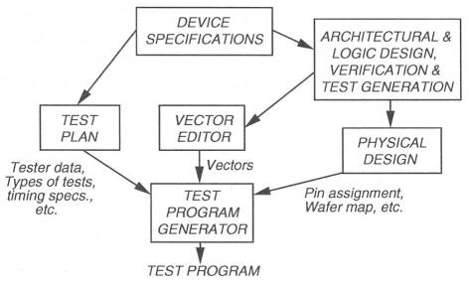
Test Programming:
Once the device-under-test has been mounted in the tester, three things are needed to conduct the test.
These are the test program, the digital test vectors, and the analog test waveforms.
Until recently, test programs were written manually.
However, the use of CAD tools is now becoming widespread in this area.
(1) Tester specification and the information on the types of tests is obtained from the test plan.
(2) Physical data on the device (pin locations, wafer map, etc.) are obtained from the layout.
(3) Timing information on signals and test vectors (inputs and expected responses) are obtained from simulators.

Slide 38
Test program generation:
The test program contains the sequence of instructions that a tester would follow to conduct testing.
For example:
A simple sequence of events will be apply power, clocks and vectors to input pins, strobe output pins, and compare output signals with stored expected response.
Modern testers provide a choice of input signal waveforms, mask output signals, sense high impedance state, and have a variety of sophisticated capabilities.
Since testers differ in their capabilities and programming languages, TPGs commonly generate a tester-independent program which can be customized to any specific ATE.
Also, since software simulators used in design verification differ from the ATE in their handling of signal format (logic values, timing, etc.), vector editors are useful tools during test programming.

Slide 39
Test Data Analysis:
The test data obtained from the ATE serves three purposes.
First, it helps to accept or reject the device-under-test.
Second, it provides useful information about the fabrication process.
And third, it provides information about design weaknesses.
Analysis of test data provides information on device quality. Due to the random variations in the fabrication process speed characteristics of devices vary. Test data analysis allows sorting of chips for higher than the nominal performance.
Failure mode analysis (FMA) of the failed devices provides further information for improving the VLSI processing.
Failing devices often show patterns of repeated failures.
The causes of these failures can point to weaknesses (sensitivity to process variations) in the design. Such information is useful for improving logic and layout design rules

Slide 40
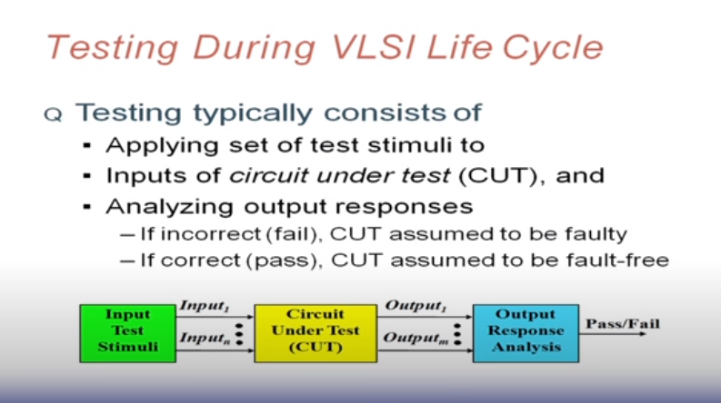

Slide 41
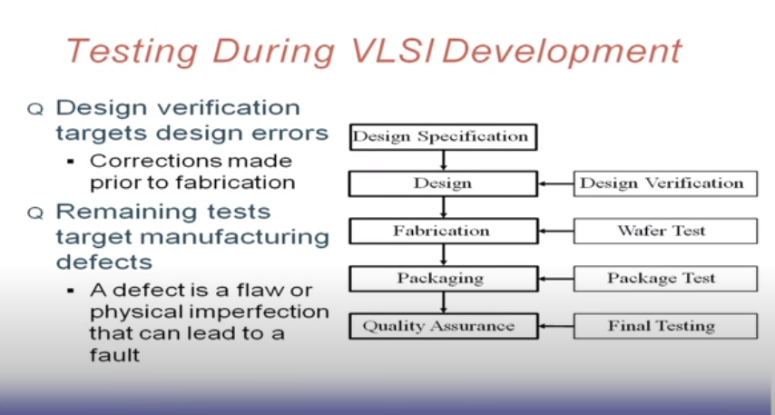

Slide 42
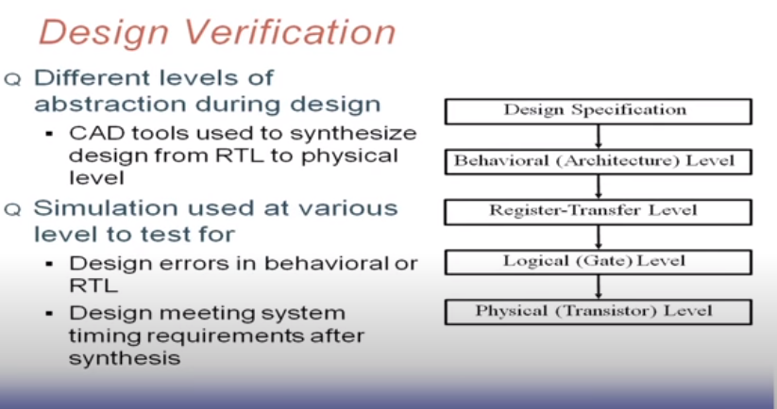

Slide 43
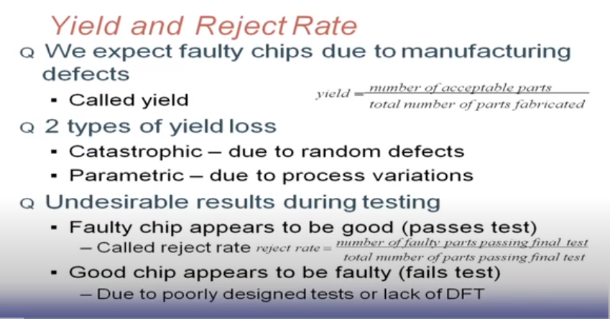

Slide 44
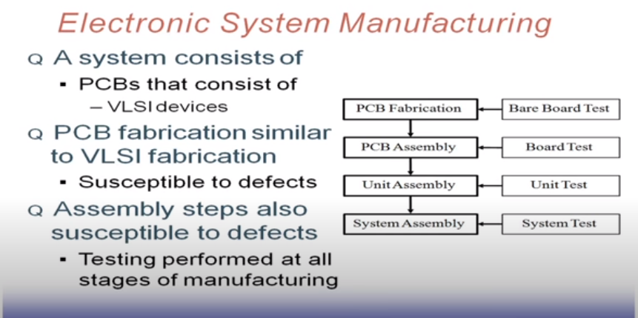

Slide 45
FAULT MODELING
Defects, Errors, and Faults
Incorrectnesses in electronic systems are described in several ways.
A reader may find that the terms defect, error, and fault are sometimes used in confusing ways in the literature on testing.

Slide 46
Definition
Defect : A defect in an electronic system is the unintended difference between the implemented hardware and its intended design.
Some typical defects in VLSI chips are:
1. Process Defects – missing contact windows, parasitic transistors, oxide breakdown, etc.
2. Material Defects – bulk defects (cracks, crystal imperfections), surface impurities, etc.
3. Age Defects – dielectric breakdown, electro migration, etc.
4. Package Defects – contact degradation, seal leaks, etc.
Defects occur either during manufacture or during the use of devices. Repeated occurrence of the same defect indicates the need for improvements in the manufacturing process or the design of the device.
Procedures for diagnosing defects and finding their causes are known as failure mode analyses

Slide 47
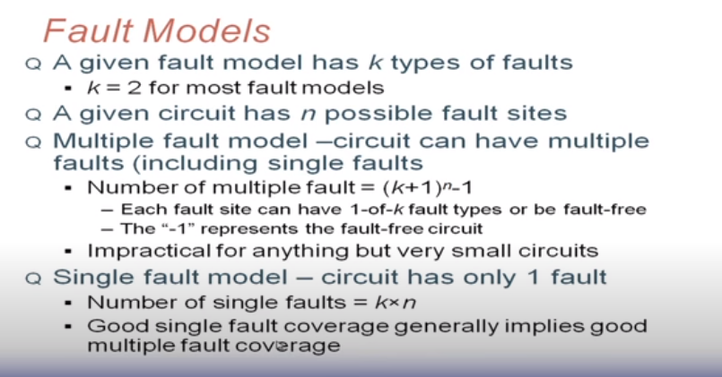

Slide 48
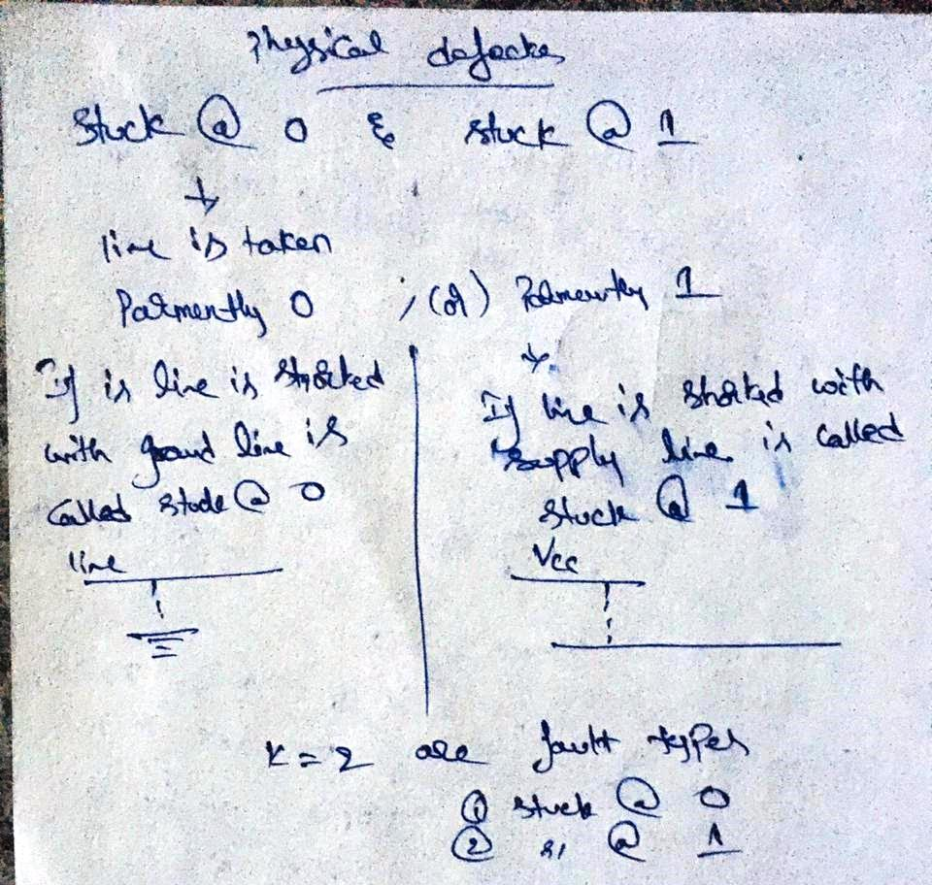

Slide 49
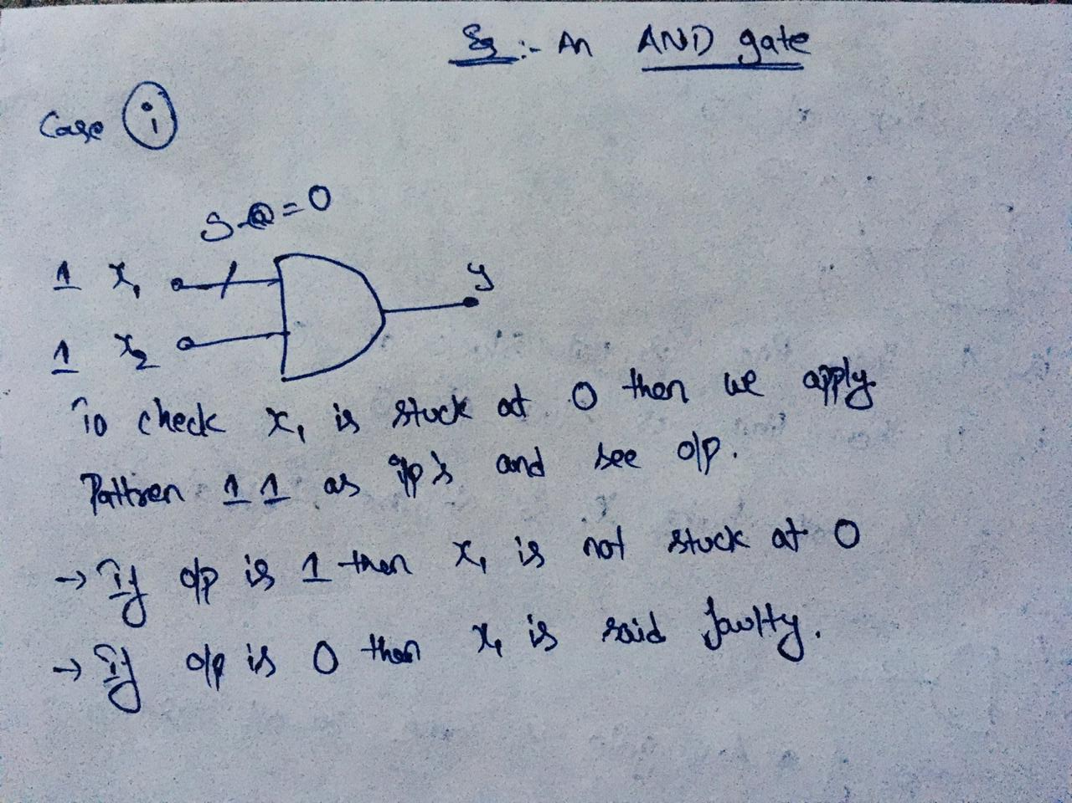
Ex:

Slide 50
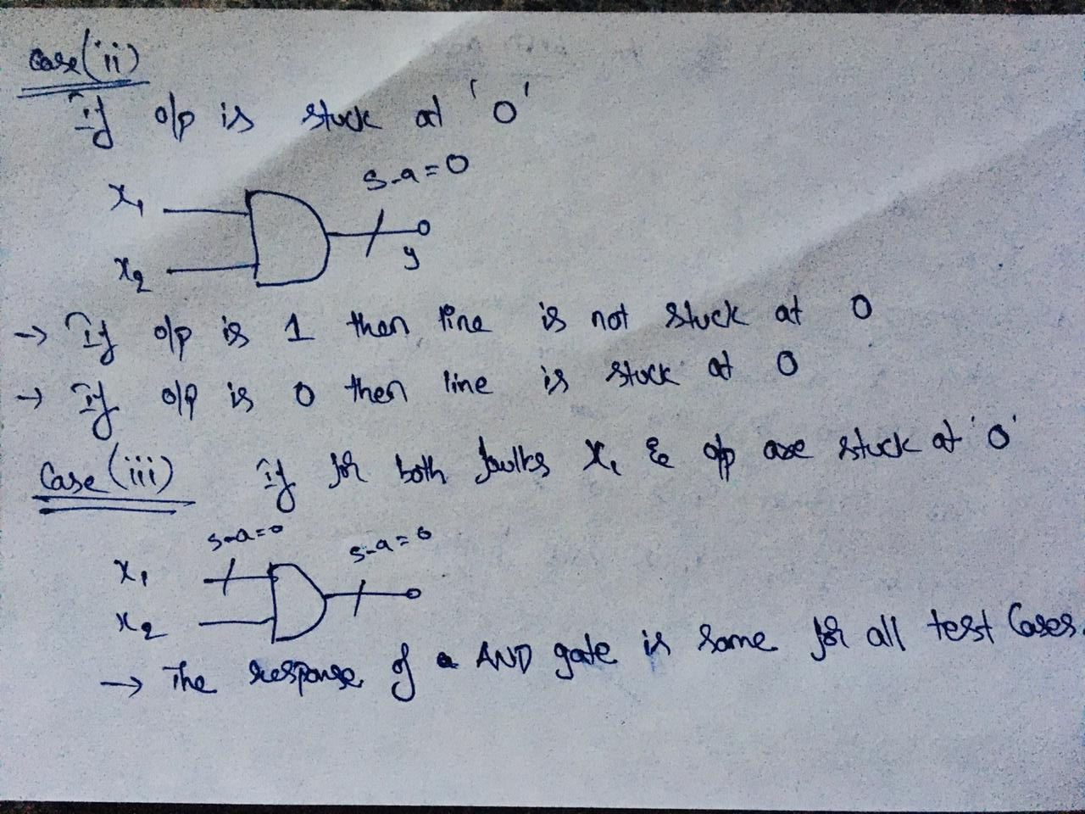

Slide 51
Stuck at Faults
Single stuck at fault model is based on following :
Only one line is faulty
Faulty line is permanently set to either ‘0’ or ‘1’
Faulty can be at input or output of a gate

Slide 52
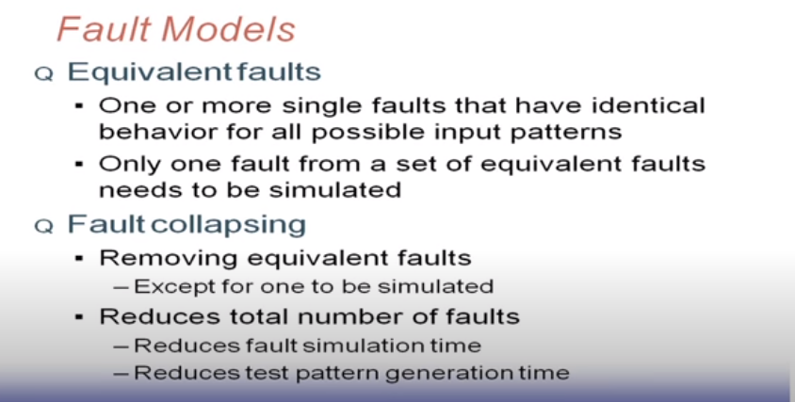

Slide 53
Definition:
Error: A wrong output signal produced by a defective system is called an error.
An error is an “effect” whose cause is some “defect.”
Definition
Fault: A representation of a “defect” at the abstracted function level is called a fault.
The difference between a defect and a fault is rather subtle. They are the imperfections in the hardware and function, respectively.

Slide 54
Levels of Fault Models
Modeling of faults is closely related to the modeling of the circuit.
The behavioral level (sometimes referred to as high level).
Highlevel fault models play a greater role in the simulation-based design verification, than in testing.
Exceptions are the functional fault models of semiconductor memories.
The register-transfer level (RTL) or logic level consists of a netlist of gates and the stuck-at faults at this level are the most popular fault models in digital testing.
Other fault models at this level are bridging faults and delay faults.
Transistor and other lower levels (referred to as component levels) include stuck open types of faults that are also known as technology-dependent faults.
Component level faults are mainly modeled in analog circuit testing
A typical example is the quiescent current (IDDQ).

Slide 55
Fault model
Nature
Value
Extent
Duration
logical
Non logical
Value of logical fault in circuit indicates that weather fault creaks fixed or erroriness values
localized
distributed
Tests weather faults is temporary or permanent
Creaks logical value at the output
Cause test of fault like malfunction of clock signal, power failure ,etc.,
Affects only single variable.
Ex: logical fault
Affects more than one
Ex: malfunction of clk signal

Slide 56
Types of Faults
Branch Fault: This fault is modeled at the behavioral level where the circuit function is described in a programming language.
A branch fault affects a branch statement and causes it to branch to an incorrect destination.
Bridging Fault: Usually modeled at the gate or transistor level, a bridging fault represents a short between a group of signals. The logic value of the shorted net may be modeled as 1-dominant (OR bridge), 0-dominant (AND bridge), or indeterminate, depending upon the technology in which the circuit is implemented.
Bus Fault: A bus fault specifies the status for each line in a bus as stuck-at-0, stuck-at-1, or fault-free. Thus, for an n-bit bus, there are 3^n -1 bus faults. A total bus fault assumes all lines of the bus to be stuck at the same 0 or 1 state

Slide 57
Cross-point Fault: These faults are modeled in programmable logic arrays (PLA.)
In the layout of a PLA, input and output variable lines are laid out perpendicular to the product-lines.
There are two types of cross-point faults.
A missing cross-point means a missing connection at a crossing where a connection was intended.
An extra crosspoint means a faulty connection at a crossing where no connection was intended.
Based on their influence on the logic function of the PLA, the cross-point faults are further classified as shrinkage, growth, appearance, and disappearance faults.
Defect-Oriented Faults: Faults at the physical level that usually occur during manufacture are called defects. The electrical or logic-level faults that can be produced by physical defects are classified as defect-oriented faults.
Examples of physical defects are broken (open) wires, bridges, improper semiconductor doping, and improperly formed devices.

Slide 58
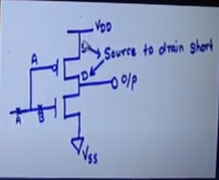
Functional Faults
Transistor Level Faults
fAULT | INPUT | OUTPUT | COMMENT
Source to drain short | 1 0 | 1 1 | Output is always High
Break at “B” | 0 1 | 1 X | PMOS is ON NMOS is Floating
Break at “A | 1 0 | X X | Floating output depends on threshold voltage (Vbin)
“A” Stuck at 1 | 1 0 | 0 0 | Output is always Low

Slide 59
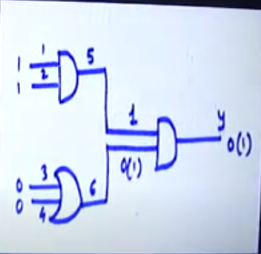
Gate Level Faults
Fault is said to be single stuck at fault at a line “L” of the circuit if the line permanently assumes a logic value either ‘0’ or 1
If input “1100” is applied and Line ‘6’ is stuck at ‘1’, the output at ‘7’ will be ‘1’ in place of expected ‘0’

Slide 60
Delay Fault: These faults cause the combinational delay of a circuit to exceed the clock period. Specific delay faults are transition faults, gate-delay faults, line-delay faults, segment-delay faults, and path-delay faults.
Gate-Delay Fault: The fault increases the input to output delay of a single logic gate, while all other gates retain some nominal values of delay.
The increase in the delay of the faulty gate is called the size of the gate-delay fault.
Hyperactive Fault: A hyperactive fault causes a large number of signals in the circuit to differ from their correct values.
The fault thus produces very high faultrelated activity in the circuit.
If not readily detected, fault simulators usually remove hyperactive faults for later consideration to save CPU time and memory

Slide 61
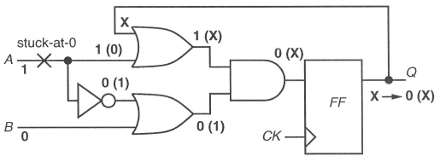
Initialization Fault: Circuits with memory elements (e.g., flip-flops) are designed so that they can be initialized by applying suitable input signals.
Faults that interfere with such an initialization procedure are called initialization faults.
Instruction Fault: Usually modeled in programmable systems like microprocessors or digital signal processors, an instruction fault causes an intended instruction to be incorrectly executed.
Intermittent Fault: A fault that appears and disappears as a function of time is called an intermittent fault.

Slide 62
Line-Delay Fault: This fault models rising and falling delays of a given signal line.
In contrast with the transition fault where the transition can be propagated through any path, a test for a line-delay fault must propagate the transition through the longest sensitizable path.
multiple stuck-at faults

Slide 63
Logical Faults: These faults affect the state of logic signals. Normally, the state may be modeled as {0, 1, X (unknown), Z (high impedance)}, and a fault can transform the correct value to any other value.
Memory Faults: Faults modeled in memory blocks are single cell stuck-at-[0,l] faults, pattern sensitive faults, cell coupling faults, and single stuck-at faults in the address decoder logic
Non-classical Fault: Although a non-classical fault, in general, refers to a fault other than a stuck-at fault, the term has been used for the stuck-open and stuck-short faults of MOS technologies
Oscillation Fault: These faults cause oscillating signals in the faulty circuit when the fault-free circuit remains stable. Such a condition can occur due to certain single stuck-at faults in sequential circuits that contain combinational feedback.
Oscillations can also occur in a purely combinational circuit if a bridging fault produces feedback. Oscillation faults are also referred to as star-faults
Parametric Fault: Such a fault changes the values of electrical parameters of active or passive devices from their nominal or expected values.
Examples are the threshold voltage of a transistor (active device) and values of resistors and capacitors (passive devices.)

Slide 64
Path-Delay Fault:
This fault causes the cumulative propagation delay of a combinational path to increase beyond some specified time duration.
The combinational path begins at a primary input or a clocked flip-flop, contains a connected chain of logic gates, and ends at a primary output or a clocked flip-flop.
The specified time duration can be the duration of the clock period (or phase), or the vector period.
Propagation delay is defined for the propagation of a signal transition through the path.
Thus, for each combinational path there are two path-delay faults, which correspond to the rising and falling transitions, respectively.
Pattern Sensitive Fault: This fault causes an incorrect behavior in a certain part of the circuit only when a specific state occurs in some other part.
Permanent Fault: Any faulty behavior that does not change with time is called a permanent fault.
Physical Faults: These faults cause physical changes in the circuit.
Examples of physical faults are broken wires, bridges (shorts) between conductors carrying unconnected signals, shorted or open transistors, etc.

Slide 65
Pin Fault: When a circuit is modeled as an interconnect of modules, the terminals of those modules are referred to as pins. This term is adopted from the technology of printed circuit boards (PCBs), which contain interconnecting wiring between the pins of the mounted chips.

Slide 66
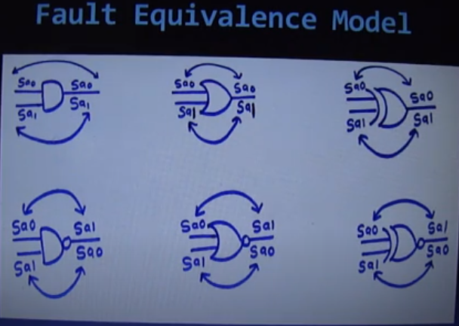
Fault Equivalence Model for Test Vectors
Ex: gates : AND , OR, EX-0R
NAND, NOR, EX-NOR

Slide 67
Fault Equivalence :
Equivalence Rules : handwritten\1.jpeg
Example : handwritten\2.jpeg
Fault Dominance:
Dominance Rules :
Example : handwritten\3.jpeg

Slide 68
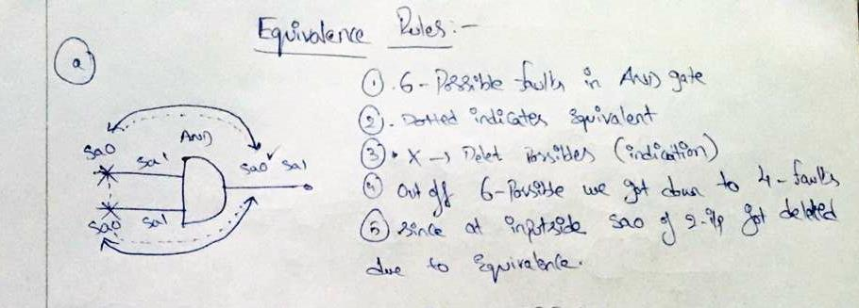

Slide 69
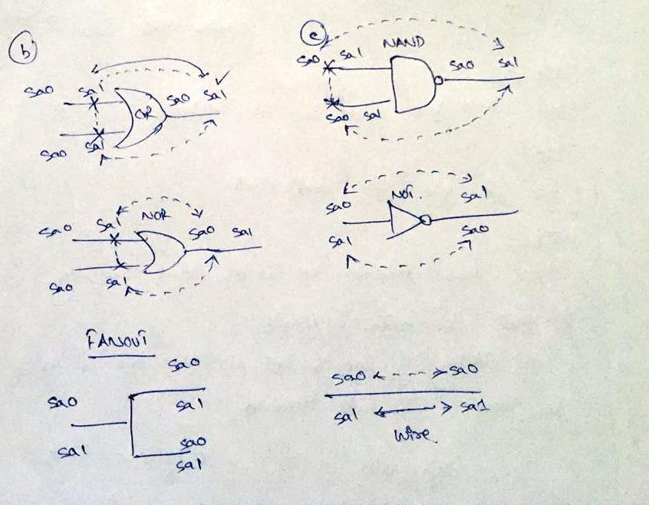

Slide 70
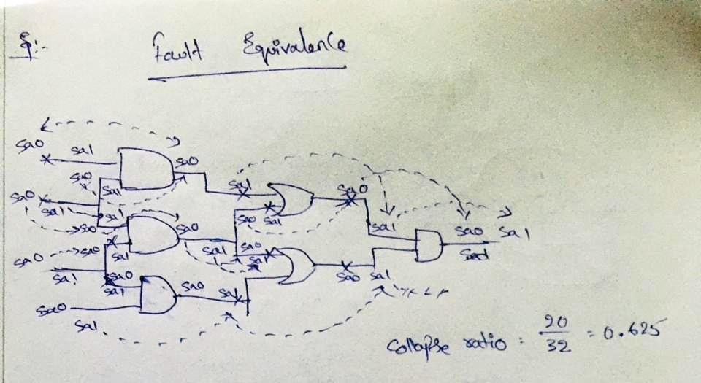

Slide 71
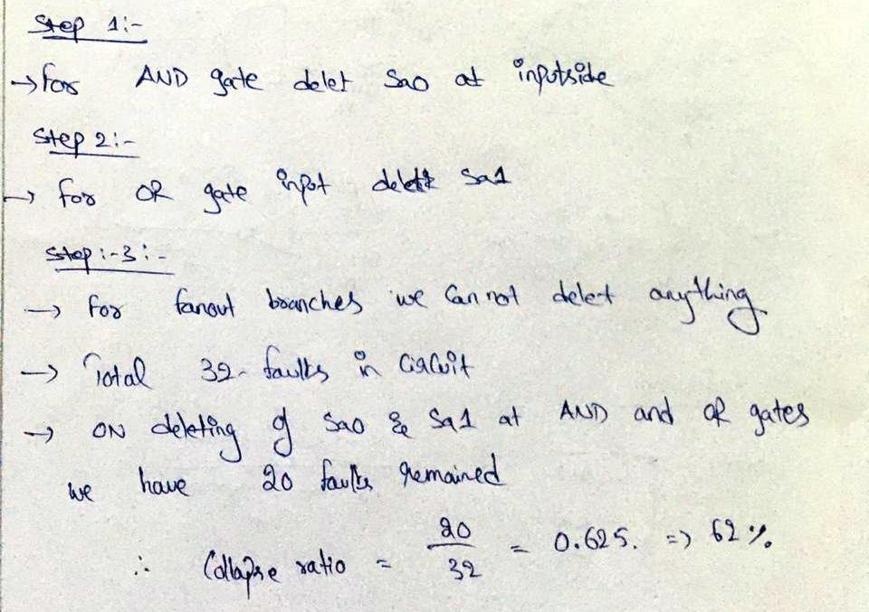

Slide 72
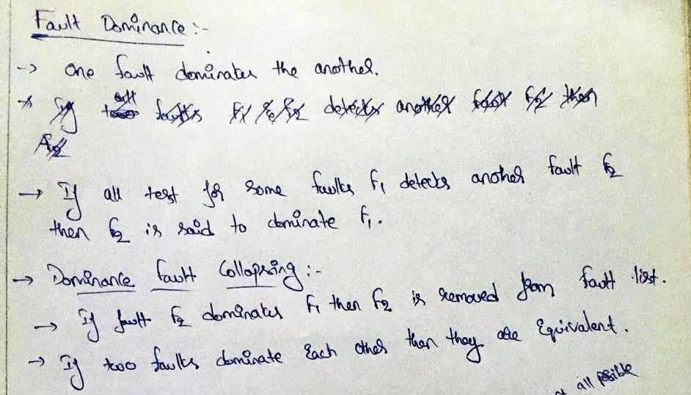

Slide 73
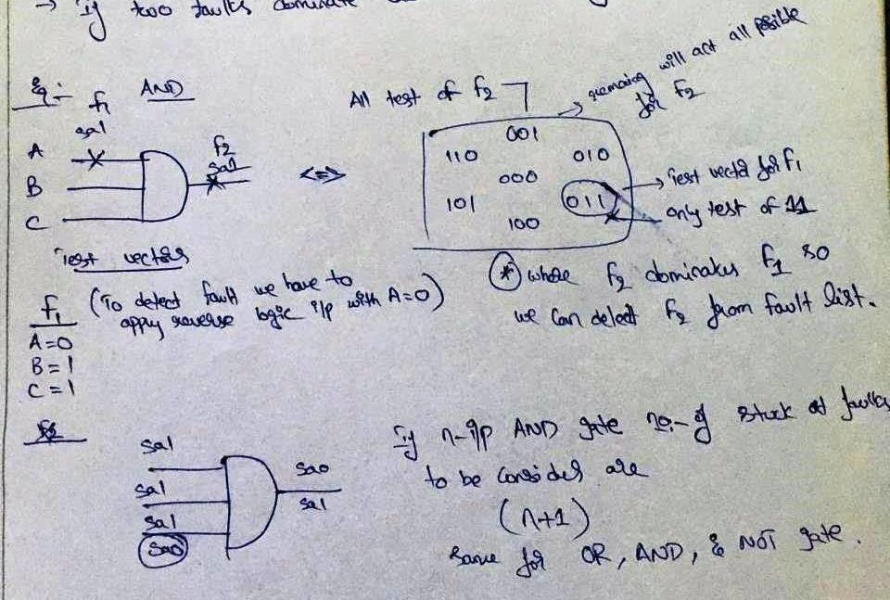

Slide 74
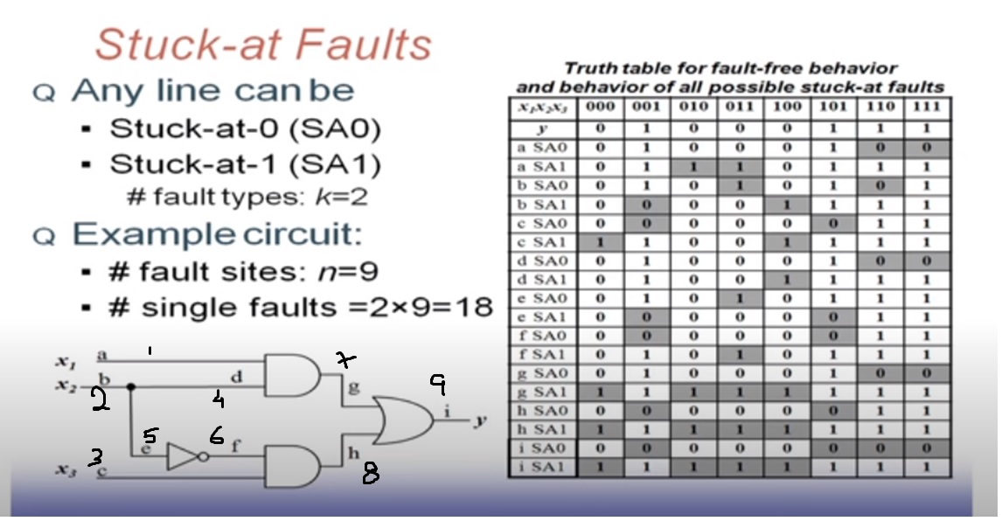

Slide 75
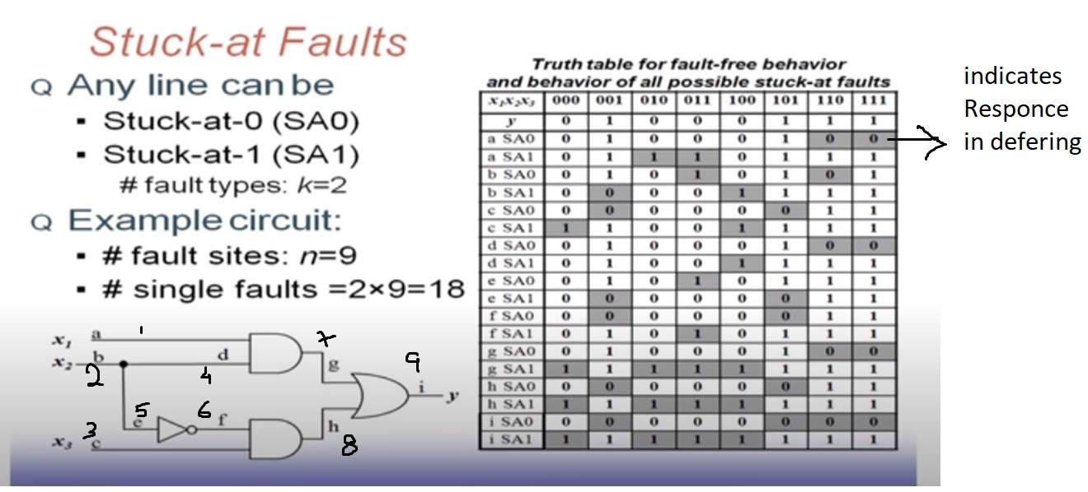

Slide 76
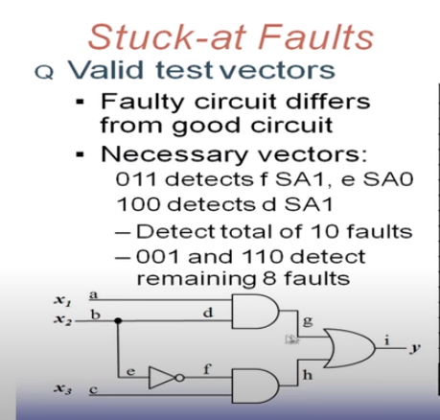
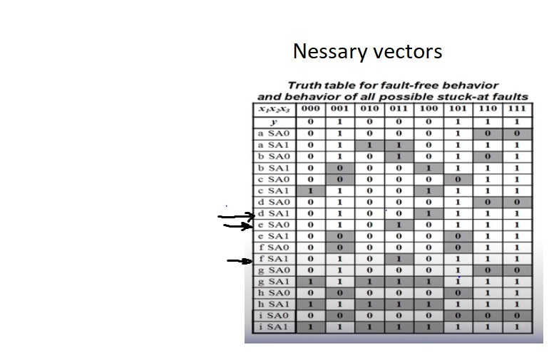

Slide 77
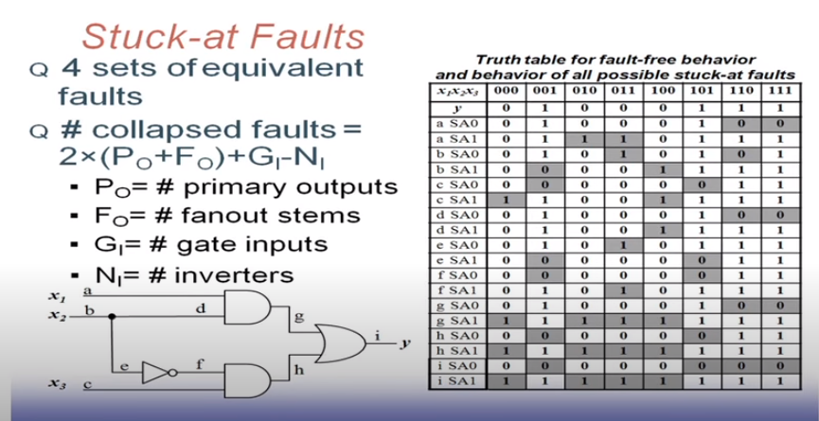

Slide 78
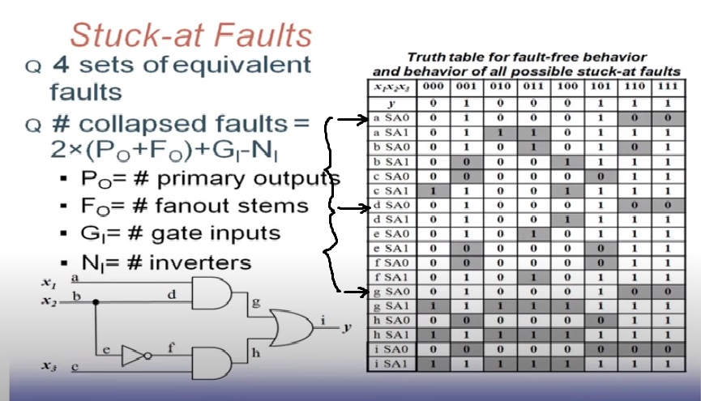

Slide 79
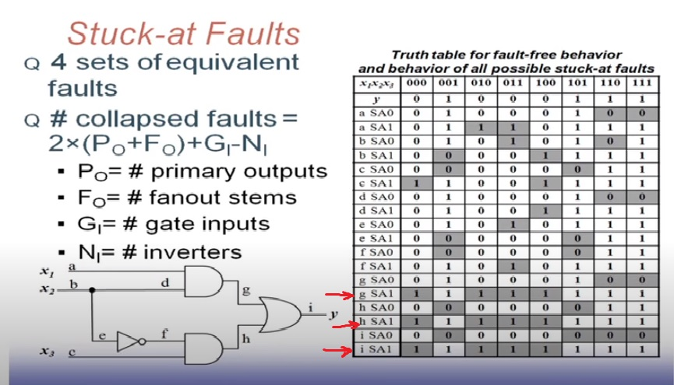

Slide 80
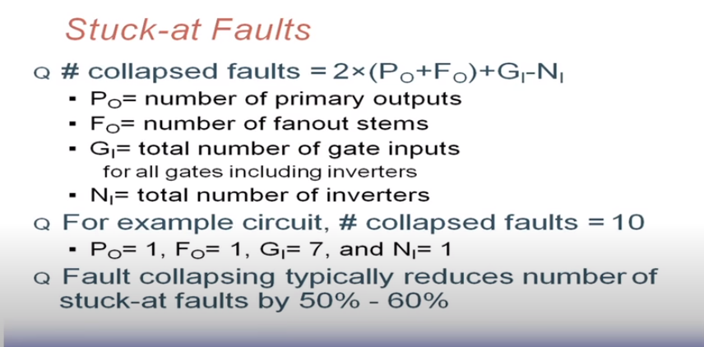

Slide 81
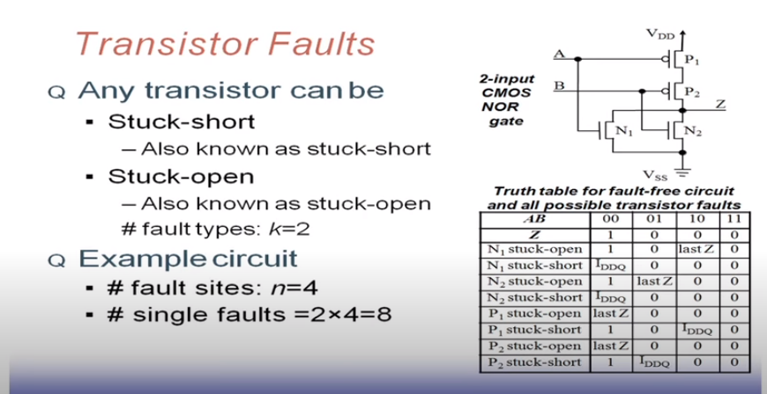

Slide 82
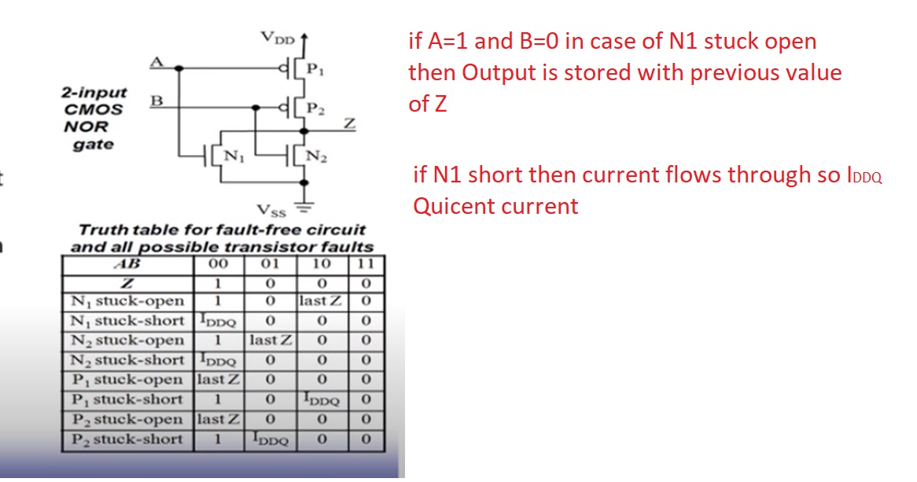

Slide 83
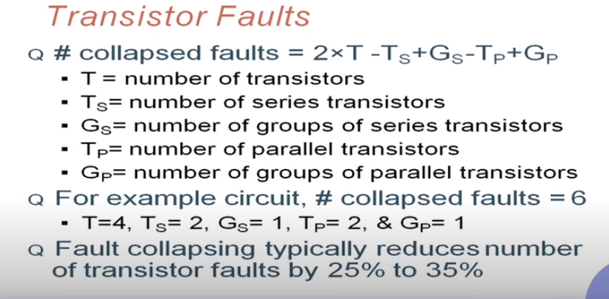

Slide 84
THANK YOU

